Slide 1
Access Control Lists
(ACLs)
Chapter 12

Slide 2
Using ACLs to Secure Networks
ACLs enable you to control traffic into and out of your network.
  Can be as simple as permitting or denying network hosts or addresses.
  Or to control network traffic based on the TCP port being used.

Slide 3
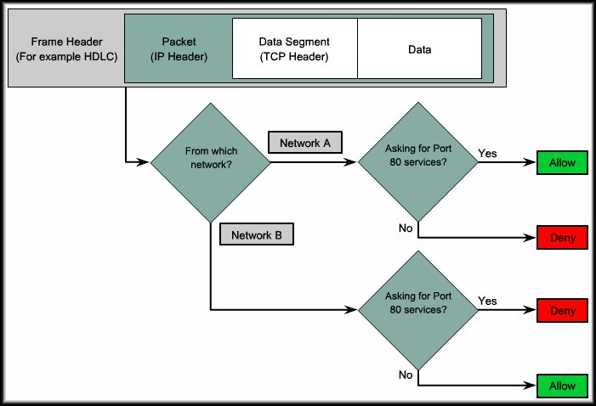
Using ACLs to Secure Networks
For Example:
Web HTML OK for Network A but not for Network B.

Slide 4
What is an ACL?
An Access Control List (ACL) is:
  A sequential list of permit or deny statements.
    Apply to IP addresses (Layer 3 header)
    Apply to upper-layer protocols (Layer 4 header).
  Controls whether a router permits or denies packets to pass through the router.
By default, a router does not have any ACLs.

Slide 5
Why do we need ACLs?
Limit network traffic and increase network performance.
Provide traffic flow control.
Provide a basic level of security for network access.
  Decide which types of traffic are forwarded or blocked at the router interfaces.
  Allow an administrator to control what areas a client can access on a network.
  Screen certain hosts to either allow or deny access to part of a network.
  Grant or deny user permission to access only certain types of files such as FTP or HTTP.

Slide 6
The Three P’s
One ACL per protocol:
  An ACL must be defined for each protocol enabled on the interface.
One ACL per direction:
  ACLs control traffic in one direction at a time on an interface.
    Two separate ACLs must be created to control:
      Inbound Traffic: Traffic coming into the interface.
      Outbound Traffic: Traffic leaving an interface.
One ACL per interface:
  ACLs control traffic for an interface (Fa0/0, s0/0/0).

Slide 7
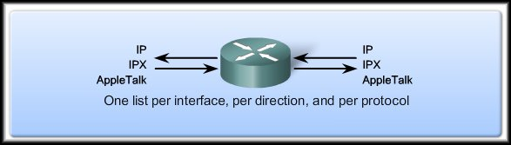
The Three P’s
Fa0/0
S0/0/0
        One Access Control List per protocol.
        One Access Control List per direction.
        One Access Control List per interface.
  How many possible ACLs?
    3 protocols X 2 directions X 2 ports
    Possibility of 12 separate lists.
      Note that the same list can be used on multiple interfaces.

Slide 8
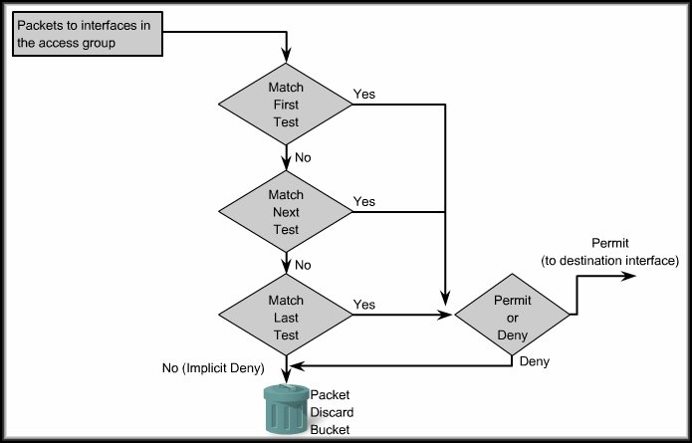
How ACLs Work
Inbound
ACL
We have to assign the list of ACLs to the interface and specify the direction of the traffic to be checked.

Slide 9
How ACLs Work
Inbound
ACL
ACL statements are processed in a sequential, logical order.
The logic used to create the list and the order of the list items is very important.

Slide 10
How ACLs Work
Inbound
ACL
Implicit Deny
If a condition match is true, the packet is permitted or denied and the rest of the ACL statements are not checked.
If all the ACL statements are unmatched, an implicit deny any statement is placed at the end of the list by default.

Slide 11
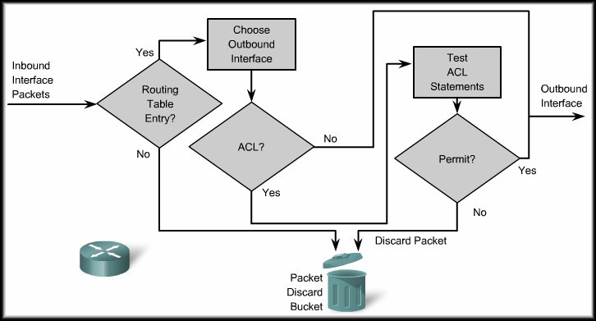
How ACLs Work
Outbound
ACL
Before a packet is forwarded to an outbound interface, the router checks the routing table.
Next, the router checks to see whether the outbound interface is assigned to an ACL List.

Slide 12
How ACLs Work
Outbound
ACL
If no ACL is present, the packet is forwarded out the interface.
If an ACL is present, the packet is tested by the combination of ACL statements that are associated with that interface.

Slide 13
How ACLs Work
Outbound
ACL
Implicit Deny
The packet is either permitted (sent to the outbound interface) or denied (dropped).
If the packet does not meet any of the criteria, it is dropped (Implicit Deny).

Slide 14
How ACLs Work
Access list statements operate in sequential, logical order.
They evaluate packets from the top - down.
Once there is an access list statement match, the router skips the rest of the statements.
If a condition match is true, the packet is permitted or denied.
There can be only one access list per protocol, per interface.
There is an implicit deny any at the end of every access list.
  ACLs do not block packets that originate within the router. (i.e. pings, telnets, ssh, etc.)

Slide 15
Types of Cisco ACLs
Two types:
  Standard ACLs:
    Standard ACLs allow you to permit or deny traffic based on the source IP addresses.
    The destination of the packet and the ports involved do not matter.
    Permit all traffic from network 192.168.30.0/24 network.
    Because of the implied "deny any" at the end, all other traffic is blocked with this ACL.

Slide 16
Types of Cisco ACLs
Two types:
  Extended ACLs:
    Extended ACLs filter IP packets based on several attributes;
      Protocol type, source and/or destination IP address, source and/or destination TCP or UDP ports.
      Permits traffic originating from any address on the 192.168.30.0/24 network to any destination host port 80 (HTTP).

Slide 17
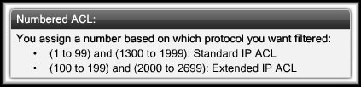
Numbering and Naming ACLs
Using numbered ACLs is an effective method for determining the ACL type on smaller networks with more homogeneously defined traffic.

Slide 18
Numbering and Naming ACLs
When configuring ACLs on a router, each ACL must be uniquely identified by assigning a number.
One group numbered 8
Multiple groups
access list 8 permit…
access list 8 permit…
access list 8 permit…
access list 8 permit…
access list 1 permit…
access list 2 permit…
access list 3 permit…
access list 4 permit…

Slide 19
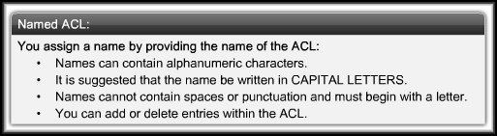
Numbering and Naming ACLs
Using named ACLs:
  A numbered ACL does not tell you the purpose of the list.
  Starting with Cisco IOS Release 11.2, you can use a name to identify a Cisco ACL.

Slide 20
Where to Place ACLs
ACLs can act as firewalls to filter packets and eliminate unwanted traffic.
  Every ACL should be placed where it has the greatest impact on efficiency.
  The basic rules are:
    Standard ACLs do not specify a destination address. Place them as close to the destination as possible.
    Extended ACLs are located as close as possible to the source of the traffic denied.
      Undesirable traffic is filtered without crossing the network infrastructure.

Slide 21
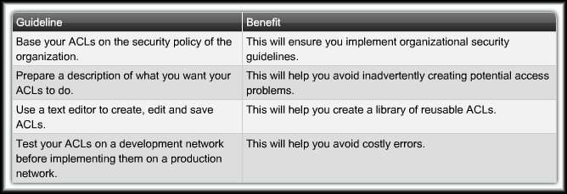
General Guidelines for Creating ACLs
ACL Best Practices:

Slide 22
Access Control Lists
Configuring Standard ACLS

Slide 23
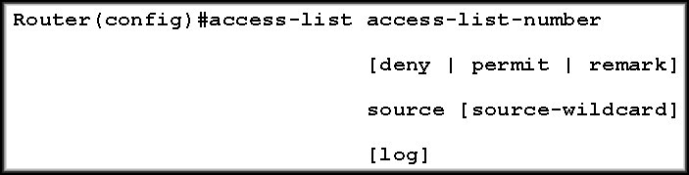
Configuring a Standard ACL
To configure a standard ACL you must:
  Create the standard ACL
  Activate the ACL on an interface.
    The access-list global configuration command defines a standard ACL with a number in the range of 1 to 99 or 1300 to 1399.
Notes:
(Optional) Causes an informational logging message about the packet that matches the entry to be sent to the console. (The level of messages logged to the console is controlled by the logging console command.)
The message includes the ACL number, whether the packet was permitted or denied, the source address, and the number of packets. The message is generated for the first packet that matches, and then at five-minute intervals, including the number of packets permitted or denied in the prior five-minute interval.

Slide 24
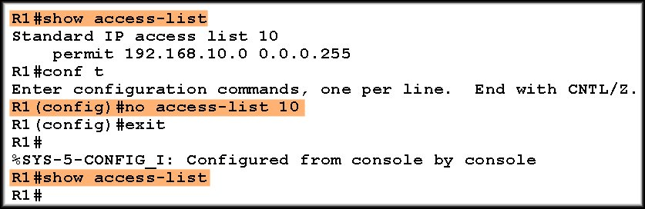
Configuring a Standard ACL
For Example:
  To create a numbered ACL designated 10 that would permit network 192.168.10.0 /24, you would enter:
  To remove an access list, use the no form of the command.

Slide 25
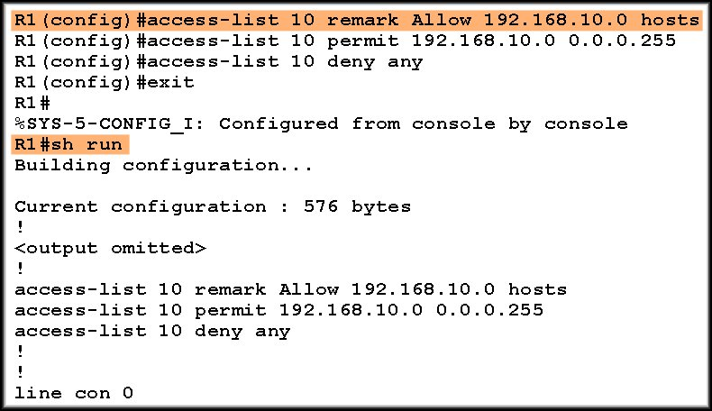
Configuring a Standard ACL
For Example:
  The remark keyword is used for documentation and makes access lists a great deal easier to understand.
Max. 100 characters
Note where the access list
appears in the
running configuration.

Slide 26
ACL Wildcard Masking
Wildcard Masking:
  ACLs statements include wildcard masks.
    (Remember OSPF network entries?)
  A wildcard mask is a string of binary digits telling the router to check specific parts of the subnet number.
    The numbers 1 and 0 in the mask identify how to treat the corresponding IP address bits.
  Wildcard masks are referred to as an inverse mask.
    Unlike a subnet mask in which binary 1 is equal to a match (network) and binary 0 is not a match (host), the reverse is true.
    It also does not have to be contiguous 1’s and 0’s.

Slide 27
ACL Wildcard Masking
Wildcard Masking:
  Wildcard masks use the following rules to match binary 1s and 0s:
    Wildcard mask bit 0:
      The corresponding bit value in the IP Address to be tested must match the bit value in the address specified in the ACL.
    Wildcard mask bit 1:
      Ignore the corresponding bit value.

Slide 28
ACL Wildcard Masking
Checking/Calculating the Wildcard Mask
Network 172.16.32.0 Subnet Mask 255.255.240.0
Subnet Mask | 255 . | 255 . | 240 . | 0
plus Wildcard Mask | 0 . | 0 . | 15 . | 255
 | 255 . | 255 . | 255 . | 255
We can calculate the Wildcard Mask using the Subnet Mask.
 | 255 . | 255 . | 255 . | 255
minus Subnet Mask | 255 . | 255 . | 240 . | 0
Wildcard Mask | 0 . | 0 . | 15 . | 255

Slide 29
Time for some Practice!
RouterB(config)#access-list 10 permit ? ?
Permit the following networks: Address / Wildcard Mask
A
172.16.0.0 255.255.0.0
172.16.0.0 0.0.255.255
B
172.16.1.0 255.255.255.0
172.16.1.0 0.0.0.255
C
192.168.1.0 255.255.255.0
192.168.1.0 0.0.0.255
D
172.16.16.0 255.255.240.0
172.16.32.0 0.0.15.255
E
172.16.128.0 255.255.192.0
172.16.128.0 0.0.63.255
Permit the following hosts:
A
172.16.10.100
172.16.10.100 0.0.0.0
B
192.168.1.100
192.168.1.100 0.0.0.0
C
All hosts
0.0.0.0 255.255.255.255

Slide 30
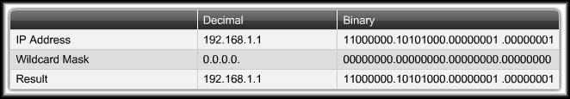
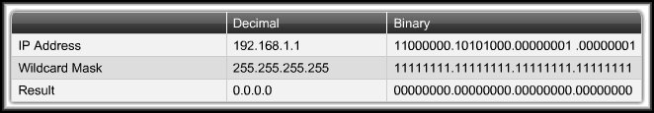
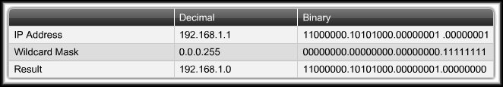
ACL Wildcard Masking
Wildcard Masking:
Just this host
Any Host
Subnet Hosts

Slide 31
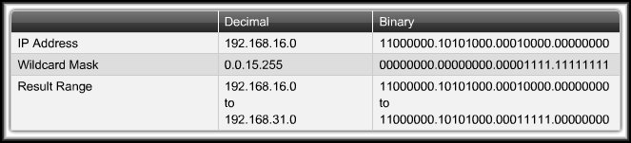
ACL Wildcard Masking
Wildcard Masking:
All IP addresses that have a match in the
first 20 bits of the address.
All Subnets 192.168.16.0 to 192.168.31.0

Slide 32
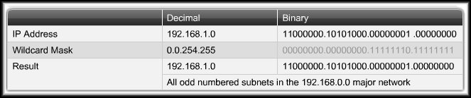
ACL Wildcard Masking
Wildcard Masking:
00000000.00000000.11111110.11111111
All IP addresses that have a match in the
first 16 bits of the address and
the last bit of the second octet.
All Odd numbered subnets in 192.168.0.0

Slide 33
ACL Wildcard Masking
Wildcard Bit Mask Keywords:
  The keywords host and any help identify the most common uses of wildcard masking.
    host:
      Used instead of 0.0.0.0 for the wildcard mask (all IP address bits must match).
    any:
      Used instead of 255.255.255.255 for the wildcard mask (accept any addresses).

Slide 34
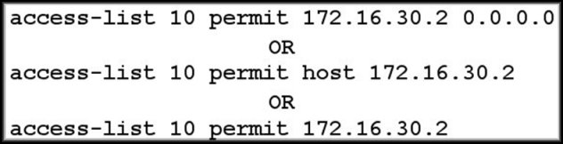
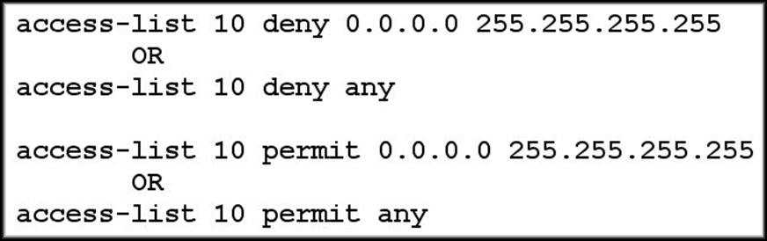
ACL Wildcard Masking
Wildcard Bit Mask Keywords:
OR
OR
OR
OR

Slide 35
Applying Standard ACLs to Interfaces
You can define ACLs without applying them but they will have no effect until they are applied to the router's interface.
  Remember……It is a good practice to:
    Apply the Standard ACLs on the interface closest to the destination of the traffic.
    Apply Extended ACLs on the interface closest to the source of the traffic.

Slide 36
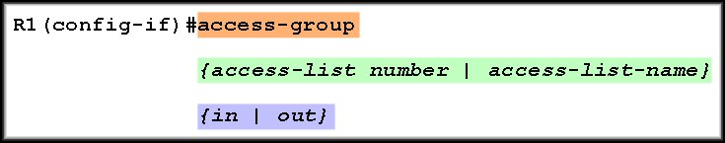
Applying Standard ACLs to Interfaces
Apply the standard ACL to an interface using the following command:
The number or name assigned during the access-list configuration.
  Consider the traffic from the router’s viewpoint.
    in: Traffic that is arriving on the interface.
    out: Traffic that has already been routed
    by the router and is leaving the interface.

Slide 37
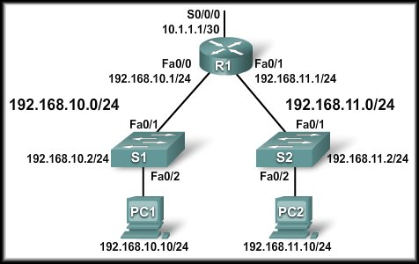
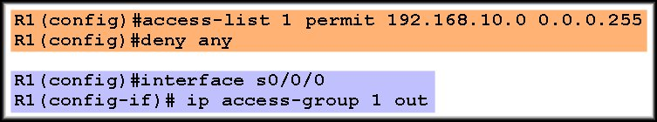
Applying Standard ACLs to Interfaces
Example 1:
  Allow only traffic from network 192.168.10.0 to exit the network on S0/0/0. Block any traffic from any other network.

Slide 38
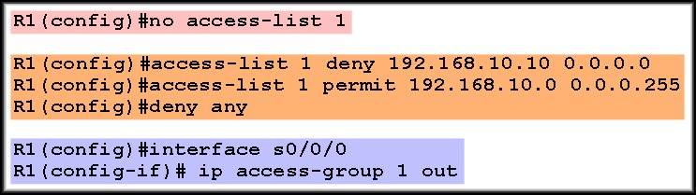
Applying Standard ACLs to Interfaces
Example 2:
  Deny any traffic from host 192.168.10.10 and allow any other 192.160.10.0 traffic to exit the network on S0/0/0. Block any traffic from any other network.

Slide 39
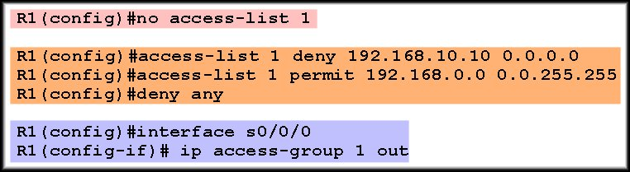
Applying Standard ACLs to Interfaces
Example 3:
  Deny any traffic from host 192.168.10.10 and allow any other subnet traffic to exit the network on S0/0/0.

Slide 40
Applying Standard ACLs to Interfaces
Using an ACL to Control VTY Access:
  If your router does not support SSH, this technique allows you to define which IP addresses are allowed Telnet access to the router EXEC process.
access-class access-list-number {in [vrf-also] | out}
List number
in – restricts incoming connections
out – restricts outgoing connections

Slide 41
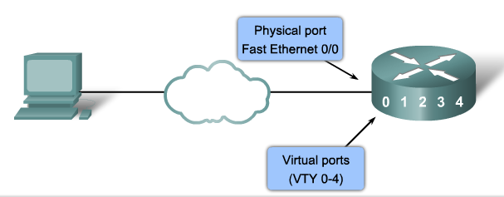


Using an ACL to Control VTY Access
Creating the ACLs:
Applying the ACLs:

Slide 42
Editing Numbered ACLs
When configuring an ACL, the statements are added in the order that they are entered at the end of the ACL.
  There is no built-in editing feature that allows you to edit a change in an ACL.
  You cannot selectively insert or delete lines.
  It is strongly recommended that any ACL be constructed in a text editor such as Notepad.

Slide 43
Editing Numbered ACLs
When configuring an ACL, the statements are added in the order that they are entered at the end of the ACL.
  Four Steps:
    Display the ACL using the show running-config command.
    Highlight the ACL, copy it, and then paste it into Notepad.
    Make your changes.
    Disable the access list using the no access-list command. Otherwise, the new statements would be appended to the existing ACL.
    Paste the new ACL into the configuration of the router.

Slide 44
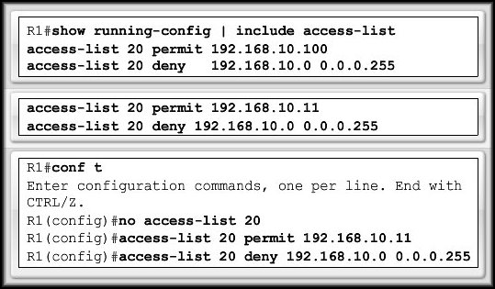
Editing Numbered ACLs
1
2
3
4
Be aware that when you use the no access-list command, no ACL is protecting your network.
  If you make an error in the new list, you have to disable it and troubleshoot the problem.

Slide 45
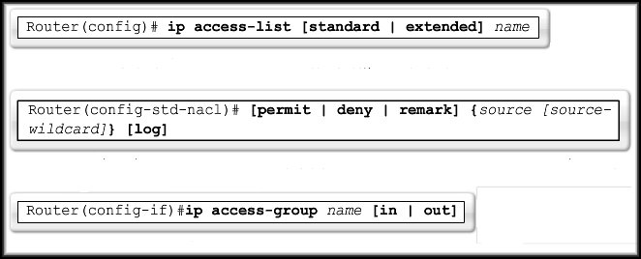
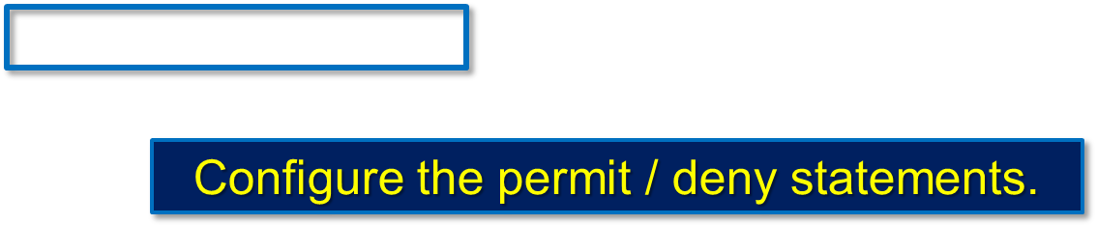
Creating Standard Named ACLs
Naming an ACL makes it easier to understand.
Must be unique and cannot start with a number.
Activate the ACL on the interface using the name.

Slide 46
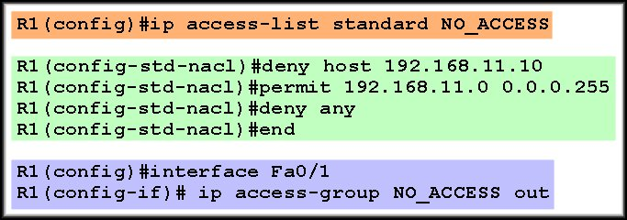
Creating Standard Named ACLs
Naming an ACL makes it easier to understand.

Slide 47
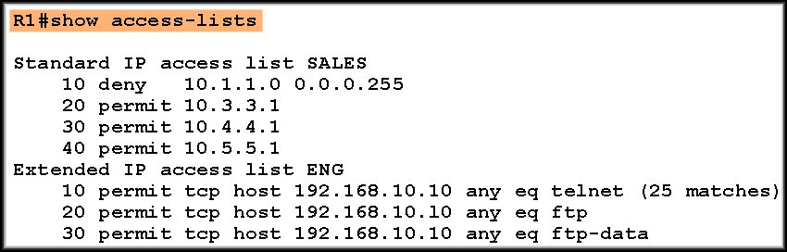
Monitoring and Verifying ACLs
Remember that there is an implied deny any
at the end of each access control list.

Slide 48
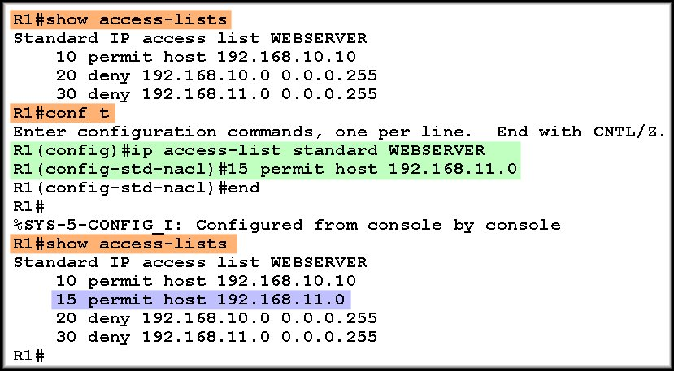
Editing Named ACLs
Named ACLs have a big advantage over numbered ACLs in that they are easier to edit.

Slide 49
Extended ACLs
Extended ACLs are used more often than standard ACLs because they provide a greater range of control.
  Extended ACLs can check:
    Source packet address.
    Destination address.
    Protocol.
    Port number or service.

Slide 50
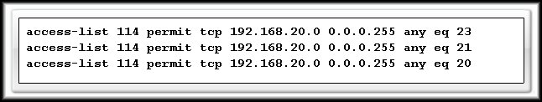
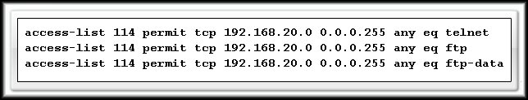
Extended ACLs
The ability to filter on protocol and port number allows you to build very specific extended ACLs.

Slide 51
Configuring Extended ACLs
Router(config)# access-list
access-list-number
{ permit | deny }
protocol
source [source-wildcard]
destination [destination-wildcard]
        operator [operand (port number / name)]
        established
As with the Standard ACL:
  The access-list command creates the list.
  The access-group command links the list to an interface and specifies the direction (in/out) that is to be checked.
  The no form of the commands removes them.

Slide 52
Configuring Extended ACLs
Router(config)# access-list
access-list-number
{ permit | deny }
protocol
source [source-wildcard]
destination [destination-wildcard]
        operator [operand (port number / name)]
        established
Range 100-199 and 2000-2699.

Slide 53
Configuring Extended ACLs
Router(config)# access-list
access-list-number
{ permit | deny }
protocol
source [source-wildcard]
destination [destination-wildcard]
        operator [operand (port number / name)]
        established
Permit:
  If this packet matches the test conditions, allow this packet to be processed.
Deny:
  If this packet matches the test conditions, drop it.

Slide 54
Configuring Extended ACLs
Router(config)# access-list
access-list-number
{ permit | deny }
protocol
source [source-wildcard]
destination [destination-wildcard]
        operator [operand (port number / name)]
        established
Can be the keyword or number of an Internet Protocol.
Keywords and numbers are available through help (?).
  To match any internet protocol (including ICMP, TCP, UDP), use the ip keyword.

Slide 55
Configuring Extended ACLs
Router(config)# access-list
access-list-number
{ permit | deny }
protocol
source [source-wildcard]
destination [destination-wildcard]
        operator [operand (port number / name)]
        established
The source and destination IP address and wildcard mask.
The format and usage of the wildcard mask is the same as in the standard ACL.
The keywords any and host can be used in the same manner as the standard ACL.

Slide 56
Configuring Extended ACLs
Router(config)# access-list
access-list-number
{ permit | deny }
protocol
source [source-wildcard]
destination [destination-wildcard]
        operator [operand (port number / name)]
        established
(Optional) compares the source or destination ports that are specified in the operand.
  Includes: lt (less than), gt (greater than), eq (equal),
  neq (not equal) and range (inclusive range).

Slide 57
Configuring Extended ACLs
Router(config)# access-list
access-list-number
{ permit | deny }
protocol
source [source-wildcard]
destination [destination-wildcard]
        operator [operand (port number / name)]
        established
If the operator and operand is positioned after the source and source-wildcard, it refers to the source port.
If the operator and operand is positioned after the destination and destination-wildcard, it refers to the destination port.

Slide 58
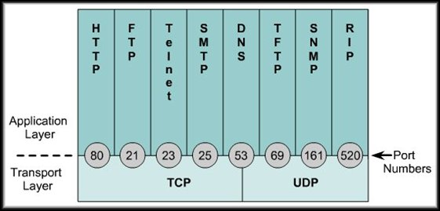
Configuring Extended ACLs
Router(config)# access-list
access-list-number
{ permit | deny }
protocol
source [source-wildcard]
destination [destination-wildcard]
        operator [operand (port number / name)]
        established
(Optional) The
decimal number or
name of a TCP or
UDP port.

Slide 59
Configuring Extended ACLs
Router(config)# access-list
access-list-number
{ permit | deny }
protocol
source [source-wildcard]
destination [destination-wildcard]
        operator [operand (port number / name)]
        established
This parameter allows responses to traffic that originates from the source network to return inbound.
With the established parameter, the router will allow only the established traffic to come back in and block all other traffic.

Slide 60
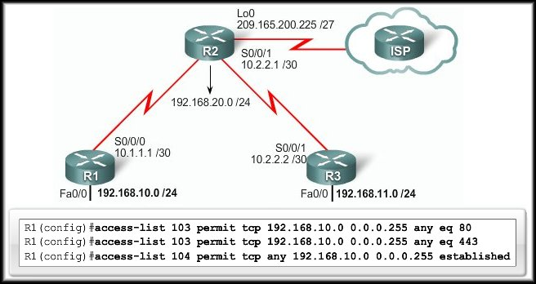
Configuring Extended ACLs
Restrict Internet access to allow only website browsing.
  ACL 103 applies to traffic leaving the network.
  ACL 104 to traffic coming into the network.

Slide 61
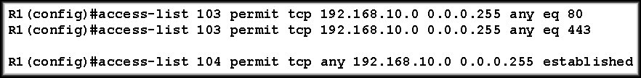
Configuring Extended ACLs
Restrict Internet access to allow only website browsing.
Command
Protocol
Operator + Operand
Number
Source
Permit/Deny
Destination
Allows traffic coming from any address on the 192.168.10.0 network to go to any destination, as long as that traffic goes to ports 80 (HTTP) and 443 (HTTPS) only.

Slide 62
Configuring Extended ACLs
Restrict Internet access to allow only website browsing.
Command
Protocol
Responses
Number
Source
Permit/Deny
Destination
The nature of HTTP requires that traffic flow back into the network. All incoming traffic, except for the established connections, is blocked from entering the network.

Slide 63
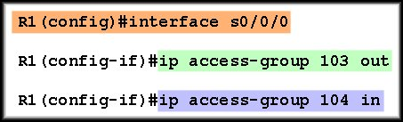
Applying Extended ACLs to Interfaces
Restrict Internet access to allow only website browsing.
  ACL 103 applies to traffic leaving the network.
  ACL 104 to traffic coming into the network.

Slide 64
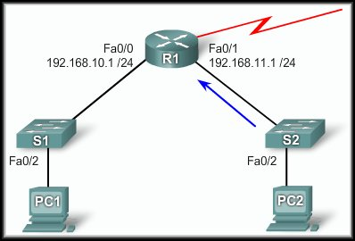
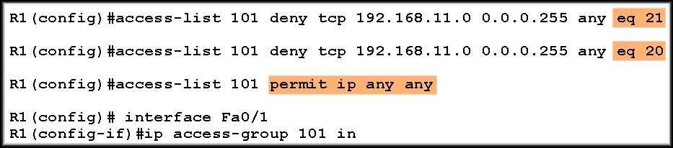
Applying Extended ACLs to Interfaces
Deny FTP:
  Deny all ftp
  from
  192.168.11.0.
eq ftp
eq ftp-data

Slide 65
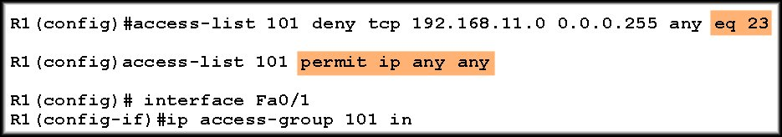
Applying Extended ACLs to Interfaces
Deny Telnet:
  Deny all telnet
  from
  192.168.11.0.
eq telnet

Slide 66
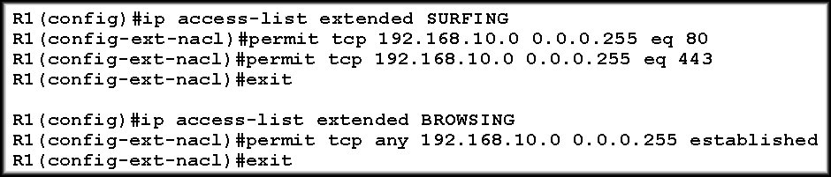
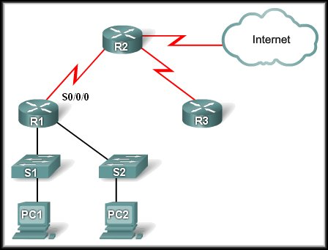
Creating Named Extended ACLs
Essentially the same way that standard names ACLs are created:
Don’t forget to apply the ACL
to all interfaces that
require the filter.

Slide 67
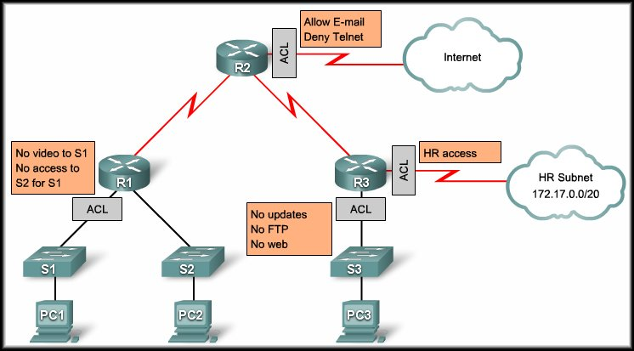
Access Control Lists
Configuring Complex ACLS

Slide 68
What Are Complex ACLs?
Three Types:
  Dynamic (lock-and-key):
    Users that want to traverse the router are blocked until they use Telnet to connect to the router and are authenticated.
  Reflexive:
    Allows outbound traffic and limits inbound traffic in response to sessions that originate inside the router.
  Time-based:
    Allows for access control based on the time of day and week.

Slide 69
Troubleshooting Common ACL Errors
Remember that ACL statements are processed in sequence from the top down. Make sure that the sequence of the ACL statements is correct.
Make sure that you permit/deny the proper protocol. Make the correct use of the TCP, UDP and IP keywords.
Always double check the use of the any keyword.
Make sure that you have applied the ACL to the correct interface and for the correct direction.
  There are specific examples of the above in the text and the curriculum.

